Slide 1
CSE101-Lec#15,16, 17
What are Arrays?
To declare an array
To initialize an array
To display address of the array
Basic program examples of 1D array
To pass an array to a function(By reference and By value)
Applications and Operations on 1D Array

Slide 2
Outline
To declare an array
To initialize an array
To display address of the array
Basic program examples of 1D array
To pass an array to a function(By reference and By value)
Applications and Operations on 1D Array

Slide 3

Introduction
Arrays
Collection of related data items of same data type.
Static entity – i.e. they remain the same size throughout program execution

Slide 4
Types
One Dimensional (e.g. int a[100])
Multidimensional(2D,3D….)(e.g. int a[5][5], int a[5][5][5])

Slide 5
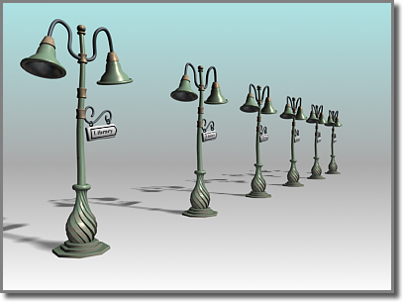
1-D array
A single- dimensional or 1-D array consists of a fixed number of elements of the same data type organized as a single linear sequence.
The elements of a single dimensional array can be accessed by using a single subscript
The arrays we have studied till now were 1D array or linear array.
Example: int a[n];

Slide 6
Arrays(1D)
Name of array (Note that all elements of this array have the same name, c)
Array
Group of consecutive memory locations
Same name and data type
To refer to an element, specify:
Array name
Position number in square brackets([])
Format:
arrayname[position_number]
First element is always at position 0
Eg. n element array named c:
c[0], c[1]...c[n – 1]
c[0]
-45
c[1]
6
c[2]
0
c[3]
72
c[4]
3
c[5]
-89
c[6]
0
c[7]
62
c[8]
-3
c[9]
1
c[10]
6453
c[11]
78
Position number of the element within array c

Slide 7
Arrays
An array is an ordered list of values
The entire array
has a single name
Each value has a numeric index
c[0] c[1] c[2] c[3] c[4] c[5] c[6] c[7] c[8] c[9]
c
79 87 94 82 67 98 87 81 74 91
An array of size N is indexed from zero to N-1
This array holds 10 values that are indexed from 0 to 9
Notes:
This will allocate 10*2 bytes of space in memory

Slide 8
Arrays
Array elements are like normal variables
c[0] = 3;/*stores 3 to c[0] element*/
scanf (“%d”, &c[1]);/*reads c[1] element*/
printf (“%d, %d”, c[0], c[1]); /*displays c[0] & c[1] element*/
The position number inside square brackets is called subscript/index.
Subscript must be integer or an integer expression
c[5 - 2] = 7; (i.e. c[3] = 7)

Slide 9
Defining Arrays
When defining arrays, specify:
Name
Data Type of array
Number of elements
datatype arrayName[numberOfElements];
Examples:
int students[10];
float myArray[3284];
Defining multiple arrays of same data type
Format is similar to regular variables
Example:
int b[100], x[27];

Slide 10
Initializing Arrays
Different ways of initializing ID Arrays
1) Initializing array at the point of declaration
int a[5]={1,2,3,4,5};
int a[]={1,2,3,4,5};//Here compiler will automatically depict the size:5
int a[5]={1,2,3};//Partial initialization[Remaining elements will be initialized to default values for integer, i.e. 0]
int a[5]={};//All elements will be initialized to zero
int a[5]={1};//First element is one and the remaining elements are default values for integer, i.e. 0

Slide 11
Initializing Arrays
2) Initializing array after taking input from the user
Array is same as the variable can prompt for value from the user at run time.
Array is a group of elements so we use for loop to get the values of every element instead of getting single value at a time.
Example: int array[5], i; // array of size 5
for(i=0;i<5;i++){// loop begins from 0 to 4
scanf(“%d”, &array[i]);
}

Slide 12
Printing base address of the array and address of any array element
#include<stdio.h>
int main()
{
int a[5]={1,2,3,4,5};
int i;
printf("\n Printing base address of the array:");
printf("\n%u %u %u",&a[0],a,&a);
printf("\n Printing addresses of all array elements:");
for(i=0;i<5;i++)
{
printf("\n%u",&a[i]);
}
return 0;
}

Slide 13
Program example 1-WAP to read and display elements of 1D Array
#include<stdio.h>
int main()
{
int a[100],n,i;
printf("\n Enter number of elements:");
scanf("%d",&n);
printf("\n Enter array elements:");
for(i=0;i<n;i++)
{
scanf("%d",&a[i]);
}
printf("\n Entered array elements are:");
for(i=0;i<n;i++)
{
printf("\n%d",a[i]);
}
return 0;
}

Slide 14
Program example-2 WAP to find the sum of all 1D array elements
#include<stdio.h>
int main()
{
int a[100],n,i,sum=0;
printf("\n Enter number of elements:");
scanf("%d",&n);
printf("\n Enter array elements:");
for(i=0;i<n;i++)
{
scanf("%d",&a[i]);
}
for(i=0;i<n;i++)
{
sum=sum+a[i];
}
printf("\n Sum of array elements is:%d",sum);
return 0;
}

Slide 15
Program example 3-WAP to display the largest and smallest element from 1D array elements
#include<stdio.h>
int main()
{
int n,a[10],i,max,min;
printf("\n Enter number of elements:");
scanf("%d",&n);
for(i=0;i<n;i++)
{
scanf("%d",&a[i]);
}
min=a[0];
for(i=1;i<n;i++)
{
if(a[i]<min)
{
min=a[i];
}
}
max=a[0];
for(i=1;i<n;i++)
{
if(a[i]>max)
{
max=a[i];
}
}
printf("\nMaximum element is: %d",max);
printf("\nMinimum element is: %d",min);
return 0;
}

Slide 16
Passing Arrays to Function
Arrays can be passed to functions in two ways:
Pass entire array
Pass array element by element

Slide 17
Pass entire array
Here entire array can be passed as an argument to the function
Function gets complete access to the original array
While passing entire array Address of first element is passed to function, any changes made inside function, directly affects the Original value.
void modifyArray(int b[], int arraySize);
Function passing method: “ Pass by Address”

Slide 18
Passing array element by element
Here individual elements are passed to the function as argument
Duplicate carbon copy of Original variable is passed to function
So any changes made inside function does not affects the original value
Function doesn’t get complete access to the original array element.
void modifyElement(int e);
Function passing method: “ Pass by Value”

Slide 19
Passing Arrays to Functions
Function prototype
void modifyArray(int b[], int arraySize);
Parameter names optional in prototype
int b[] could be written int []
int arraySize could be simply int
void modifyArray(int [], int);
Function call
int a[SIZE];
modifyArray(a, SIZE);

Slide 20
Program example-1 Passing Array to a function using by reference(or Passing entire array at once)
#include<stdio.h>
void reference(int[],int);
int main()
{
int arr[100],n;
int i;
printf("\n Enter n:");
scanf("%d",&n);
printf("\n Enter array elements:");
for(i=0;i<n;i++)
{
scanf("%d",&arr[i]);
}
printf("\n Elements by reference:");
reference(arr,n);//Passing array by call by reference
return 0;
}
void reference(int x[],int size)
{
int i;
for(i=0;i<size;i++)
{
printf("%d ",x[i]);
}
}

Slide 21
Program example-2 Passing Array to a function using by value(or Passing element by element)
#include<stdio.h>
void value(int);
int main()
{
int arr[100],n;
int i;
printf("\n Enter n:");
scanf("%d",&n);
printf("\n Enter array elements:");
for(i=0;i<n;i++)
{
scanf("%d",&arr[i]);
}
printf("\n Passing elements by value:");
for(i=0;i<5;i++)
{
value(arr[i]);//Passing array value by Call by value
}
return 0;
}
void value(int u)
{
printf("%d ",u);
}

Slide 22
Application Of Array :
Stores Elements of Same Data Type
Array is used to store the number of elements that are of same data type.
Eg: int students[30];
array of marks of five subjects for single student.
float marks[5];
array of marks of five subjects for 30 students.
float marks[30][5]
Similarly if we declare the character array then it can hold only character.
So in short character array can store character variables while floating array stores only floating numbers.

Slide 23
Array Used for Maintaining multiple variable names using single name
Suppose we need to store 5 roll numbers of students then without declaration of array we need to declare following -
int roll1,roll2,roll3,roll4,roll5;
Now in order to get roll number of first student we need to access roll1.
Guess if we need to store roll numbers of 100 students then what will be the procedure.
Maintaining all the variables and remembering all these things is very difficult.
So we are using array which can store multiple values and we have to remember just single variable name.

Slide 24
Array Can be Used for Sorting Elements
We can store elements to be sorted in an array and then by using different sorting technique we can sort the elements.
Different Sorting Techniques are :
1. Bubble Sort
2. Insertion Sort
3. Selection Sort
Notes:
To sort the elements without using array we have to compare each and every variable individually without using loops.

Slide 25
Array Can Perform Matrix Operation
Matrix operations can be performed using the array. We can use 2-D array
To store the matrix.
To perform all mathematical manipulations on matrix.
Matrix can be multi-dimensional.

Slide 26
Searching in Arrays
The process of finding a particular element of an array is called searching.
Search an array for a key value.
Two searching techniques:
Linear search
Binary search

Slide 27
Linear search
Linear search
Simple
Compare each element of array with key value
Useful for small and unsorted arrays
It simply examines each element sequentially, starting with the first element, until it finds the key element or it reaches the end of the array.
Example: If you were looking for someone on a moving passenger train, you would use a sequential search.

Slide 28
Program example-WAP to implement linear search in 1D array element
#include <stdio.h>
int main()
{
int a[50];
int i, loc = -1, key,n;
printf("\n Enter value of n:");
scanf("%d",&n);
printf("\n Enter the elements:");
for(i=0;i<n;i++)
{
scanf("%d",&a[i]);
}
printf("Enter integer value to search in array:");
scanf( "%d", &key );
// attempt to locate searchKey in array a
for ( i = 0; i < n; i++ )
{
if ( a[i] == key )
{
loc = i; // location of key is stored
break;
} // end if
} // end for
if(loc!= -1)
{
printf("Element found at %d",loc+1);
}
else
{
printf("Element not found");
}
} // end main

Slide 29
Binary search
Binary search
Applicable for sorted arrays
The algorithm locates the middle element of the array and compares it to the key value.
Compares middle element with the key
If equal, match found
If key < middle, looks in left half of middle
If key > middle, looks in right half of middle
Repeat (the algorithm is repeated on one-quarter of the original array.)

Slide 30
Binary search
It repeatedly divides the sequence in two, each time restricting the search to the half that would contain the element.
This is a tremendous increase in performance over the linear search that required comparing the search key to an average of half of the array elements.
You might use the binary search to look up a word in a dictionary

Slide 31
Program example-WAP to implement Binary Search in 1D array elements
#include<stdio.h>
int main()
{
int a[50],n,loc=-1, key, beg,last,mid,i;
printf("\n Enter number of array elements:");
scanf("%d",&n);
printf("\n Enter array elements:");
for(i=0;i<n;i++)
{
scanf("%d",&a[i]);
}
beg=0;
last=n-1;
printf("Enter integer value to search in sorted array:");
scanf( "%d", &key );
while(beg<=last)//Loop will run until unless only one element is not remaining
{
mid = (beg + last) / 2; // determine index of middle element
if(a[mid]==key)
{
loc=mid; //save the location of element.
break;
}
else if(a[mid]>key) //Middle element is greater than key
{
last=mid-1;//If middle element is greater than key, we need to search left subarray
}
else if(a[mid]<key) //Middle element is less than key
{
beg=mid+1;//If middle element is less than key, we need to search right subarray
} //end of if else
} //end of while
if(loc!=-1)
{
printf("element found at %d", loc+1);//Location is exact position, not index
}
else
{
printf("element not found");
}
return 0;
}

Slide 32
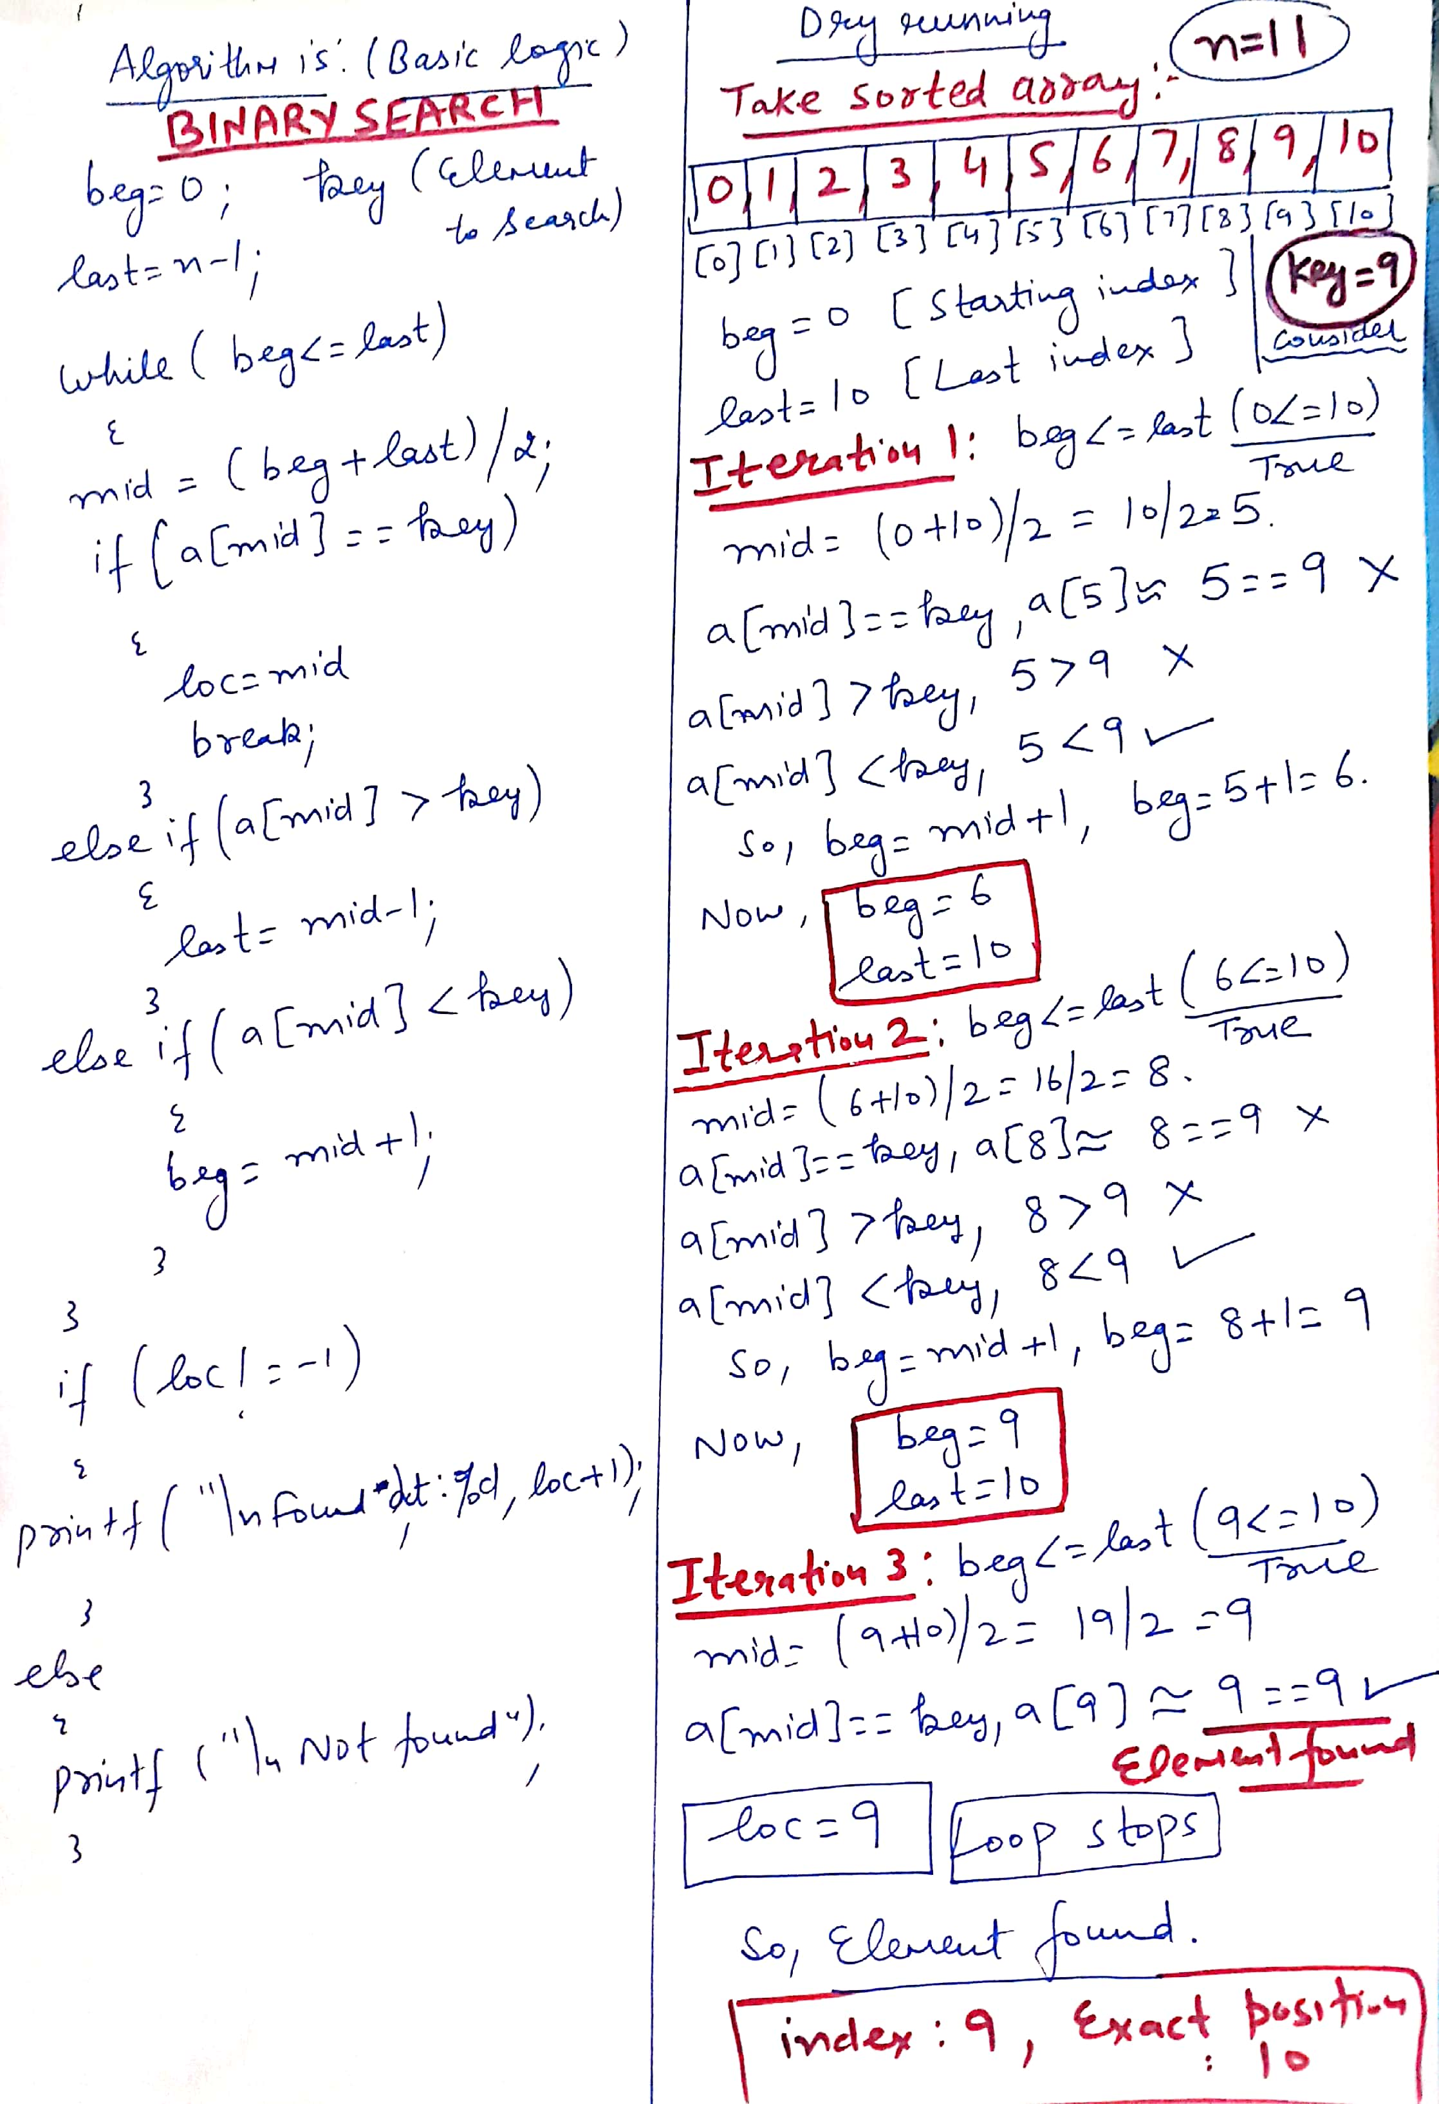
Dry running

Slide 33
Sorting
Sorting data
Important computing application
Virtually every organization must sort some data

Slide 34
Bubble sort
Bubble sort (sinking sort)
A simple but inefficient sorting technique.
Several passes through the array
Successive pairs of elements are compared
If increasing order (or identical ), no change
If decreasing order, elements exchanged
Repeat

Slide 35
Bubble sort
Comparing successive elements
77 | 56 | 4 | 10 | 34 | 2
56 | 4 | 10 | 34 | 2 | 77
4 | 10 | 34 | 2 | 56 | 77
4 | 10 | 2 | 34 | 56 | 77
4 | 2 | 10 | 34 | 56 | 77
2 | 4 | 10 | 34 | 56 | 77
Original array
After pass 1
After pass 2
After pass 3
After pass 4
After pass 5
Total number of pass required for sorting: n-1

Slide 36
Bubble sort
It’s called bubble sort or sinking sort because smaller values gradually “bubble” their way to the top of the array (i.e., toward the first element) like air bubbles rising in water, while the larger values sink to the bottom (end) of the array.
The technique uses nested loops to make several passes through the array.
Each pass compares successive pairs of elements.
If a pair is in increasing order (or the values are equal), the bubble sort leaves the values as they are.
If a pair is in decreasing order, the bubble sort swaps their values in the array.

Slide 37
Bubble sort
The first pass compares the first two elements of the array and swaps their values if necessary. It then compares the second and third elements in the array. The end of this pass compares the last two elements in the array and swaps them if necessary.
After one pass, the largest element will be in the last index. After two passes, the largest two elements will be in the last two indices.

Slide 38
Program example-WAP to sort elements of 1D array in ascending order using Bubble sort
#include <stdio.h>
int main()
{
int a[100];
int hold,i,j,n;
printf("\n Enter value of n:");
scanf("%d",&n);
printf("\n Enter elements:");
for(i=0;i<n;i++)
{
scanf("%d",&a[i]);
}
printf( "Data items in original order" );
for (i=0;i<n;i++ )
{
printf("%d ",a[i]);//Elements will come with space
} // end for
// bubble sort
// loop to control number of passes(no. of passes are always n-1)
for (i=0;i<n-1;i++)
{
// loop to control number of comparisons per pass(There is one comparison less)
for (j=0;j<n-i-1;j++)
{
// compare adjacent elements and swap them if first
// element is greater than second element
if (a[j]>a[j+1])
{
hold=a[j];
a[j]=a[j+1];
a[j+1]=hold;
} // end if
} // end inner for
} // end outer for
printf( "\nData items in ascending order" );
for (i=0;i<n;i++)
{
printf("%d ",a[i]);
} // end for
} // end main

Slide 39
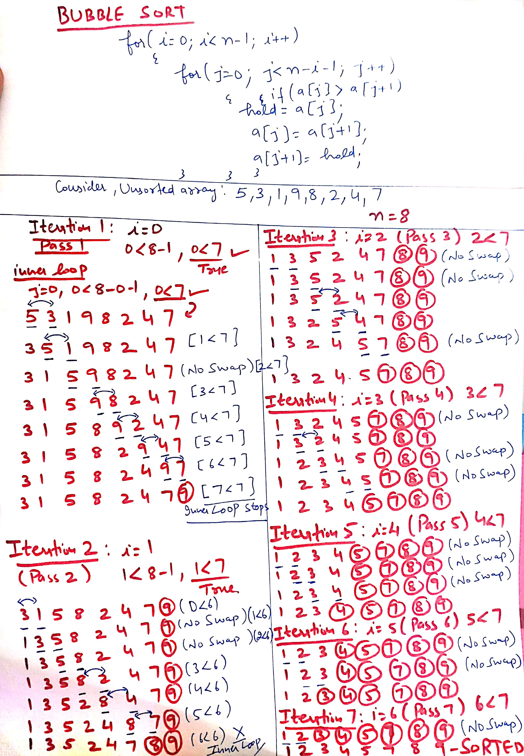
Dry running

Slide 40
Operations on arrays
Insertion of element into an array
Deletion of element from an array

Slide 41
Write a program to insert an element at a given position in 1D array
#include <stdio.h>
int main()
{
int array[100], position, c, n, value;
printf("Enter number of elements in array:\n");
scanf("%d", &n);
printf("Enter %d elements:\n", n);
for (c = 0; c < n; c++)
{
scanf("%d", &array[c]);
}
printf("Enter the location where you wish to insert an element:\n");
scanf("%d", &position);
printf("Enter the value to insert:\n");
scanf("%d", &value);
for (c = n - 1; c >= position - 1; c--)
{
array[c+1] = array[c];
}
array[position-1] = value;
printf("Resultant array is:\n");
for (c = 0; c <= n; c++)
{
printf("%d\n", array[c]);
}
return 0;
}

Slide 42
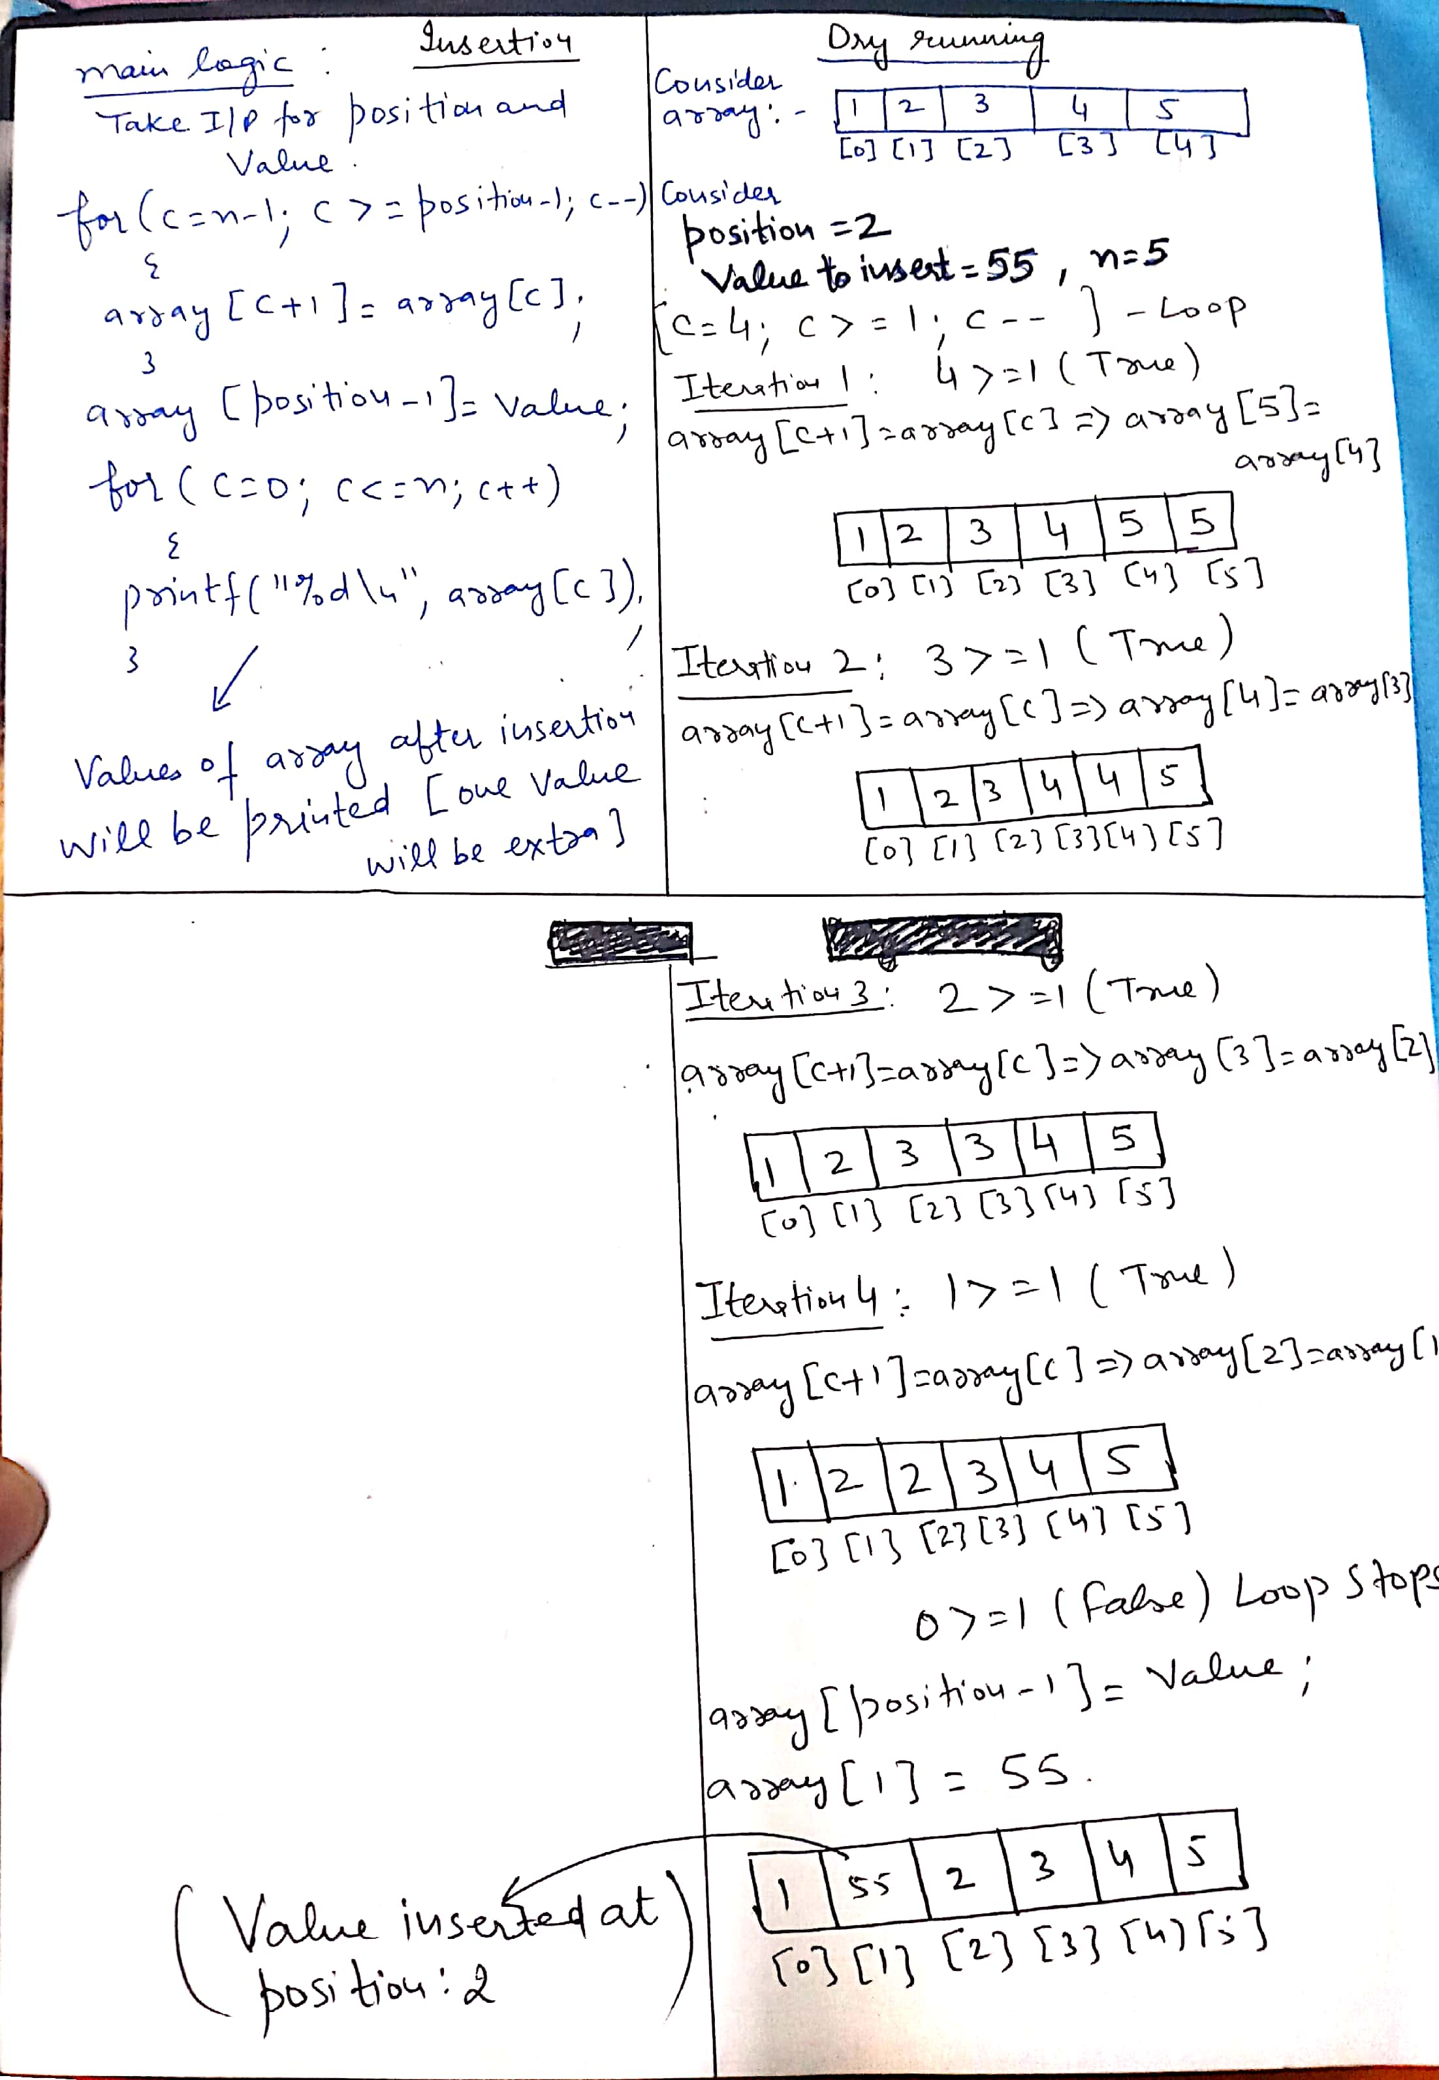
Dry running

Slide 43
Write a program delete an element from a given position in 1D array
#include <stdio.h>
int main()
{
int array[100], position, c, n;
printf("Enter number of elements in array\n");
scanf("%d", &n);
printf("Enter %d elements\n", n);
for (c = 0; c < n; c++)
{
scanf("%d", &array[c]);
}
printf("Enter the location where you wish to delete from an array\n");
scanf("%d", &position);
for (c = position-1; c < n-1; c++)
{
array[c] = array[c+1];
}
printf("Resultant array is\n");
for (c = 0; c < n-1; c++)
{
printf("%d\n", array[c]);
}
}

Slide 44
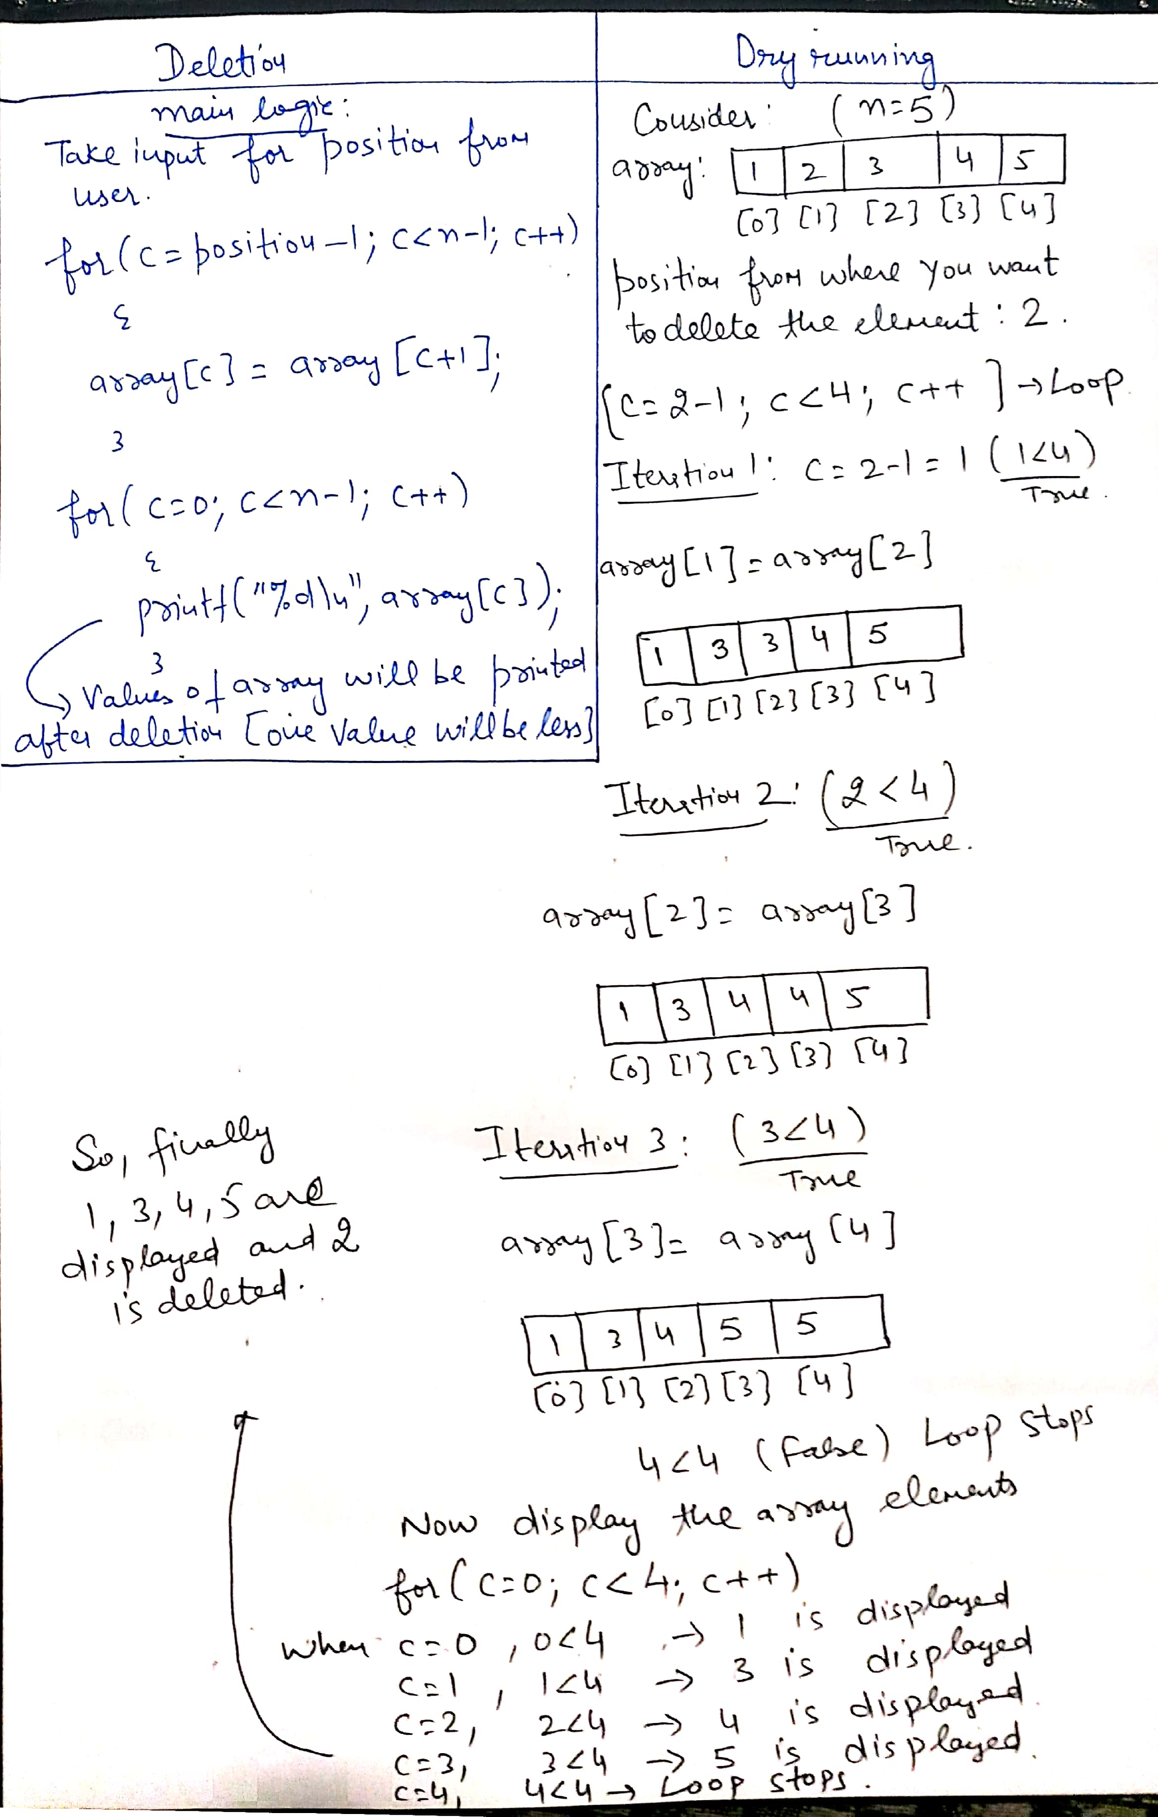
Dry running

Slide 45
Q1
If the size of the array is 100, then last index will be:
A. 100
B. 99
C. 98
D. 0
Notes:
B

Slide 46
Q2
For the given array, int a={22,3,44,8,9}; what value will be coming for a[3]??
A. 22
B. 44
C. 9
D. 8
Notes:
D

Slide 47
Q3
For the given array, int a[5]={}; what value will be coming for a[1]??
A.1
B. Garbage value
C.0
D.-1
Notes:
C

Slide 48
Q4
What will be the output of following code?
#include<stdio.h>
int main()
{
int a[5],i;
for(i=0;i<5;i++)
{
a[i]=i;
}
printf("%d",a[2]);
return 0;
}
0
2
1
Garbage value
Notes:
B

Slide 49
Q5
What will be the output of following code?
#include<stdio.h>
int main()
{
int a[5]={11,22,33,44,55};
a[2]=a[1];
a[3]=a[2];
a[4]=a[3];
printf("%d",a[4]);
return 0;
}
22
33
44
55
Notes:
A

Slide 50
Q6
#include<stdio.h>
int main()
{
int a[5]={1,2,3,4,5};
int b[5];
int i;
for(i=0;i<5;i++)
{
b[i]=++a[i];
}
printf("%d",b[0]+b[3]);
return 0;
}
A. 5
B. 7
C. 4
D. 3
Notes:
B

Slide 51
Q7
What will be the output of the following program?
#include<stdio.h>
int main()
{
int a[5] = {5, 1, 15, 20, 25};
int i=2;
printf("%d",a[++i]);
return 0;
}
A. 15
B. 20
C. 25
D. 5
Notes:
B

Slide 52
Q8
What will be the output of the following program?
#include<stdio.h>
int main()
{
int a[5] = {5, 1, 15, 20, 25};
int i, j, m;
i = ++a[1];
j = a[1]++;
m = a[i++];
printf("%d %d %d",i,j,m);
return 0;
}
A. 3, 2, 15
B. 2, 3, 20
C. 2, 1, 15
D. 1, 2, 5
Notes:
A

Slide 53
Q9
What is the output of C program.?
int main()
{
float marks[3] = {90.5, 92.5, 96.5};
int a=0;
while(a<3)
{
printf("%.2f ", marks[a]);
a++;
}
return 0;
}
A) 90.5 92.5 96.5
B) 90.50 92.50 96.50
C) 0.00 0.00 0.00
D) Compiler error
Notes:
B

Slide 54
Q10
If the number of elements in array are:20, then number of passes as per bubble sort will be
A. 20
B. 19
C. 18
D. 21
Notes:
B

Slide 55
Q11
If array elements are already arranged in ascending order, and if the key element is 23, and middle indexed element is 35, then what expression will be used as per the condition in binary search?
A. beg=mid+1
B. last=mid-1
C. mid=mid-1
D. beg=beg+1
Here, beg: starting index, last: ending index, mid:middle index
Notes:
B

Slide 56
Q12
If array elements are already arranged in ascending order, and if the key element is 98, and middle indexed element is 50, then what expression will be used as per the condition in binary search?
A. beg=mid+1
B. last=mid-1
C. mid=mid-1
D. beg=beg+1
Here, beg: starting index, last: ending index, mid:middle index
Notes:
A

Slide 57
Q13
//What will be the output of the following program?
#include<stdio.h>
void process(int[],int);
int main()
{
int a[5] = {15, 3, 10, 4, 6};
process(a,5);
printf("%d",a[0]+a[1]);
return 0;
}
void process(int x[],int z)
{
int i;
for(i=0;i<z;i++)
{
if(x[i]%5==0)
{
x[i]=-1;
}
}
}
A. 18
B. 2
C. -2
D. 3
Notes:
B

